Slide 1


Slide 2



This course material by Osama Salah is released under the following license:
Attribution-ShareAlike 4.0 International (CC BY-SA 4.0)
Conditions for use are published here:
https://creativecommons.org/licenses/by-sa/4.0/

Slide 3
Acknowledgement
I would like to thank and acknowledge the following people for their valuable contributions to this course material:
Have your name and effort acknowledged here!!!

Slide 4
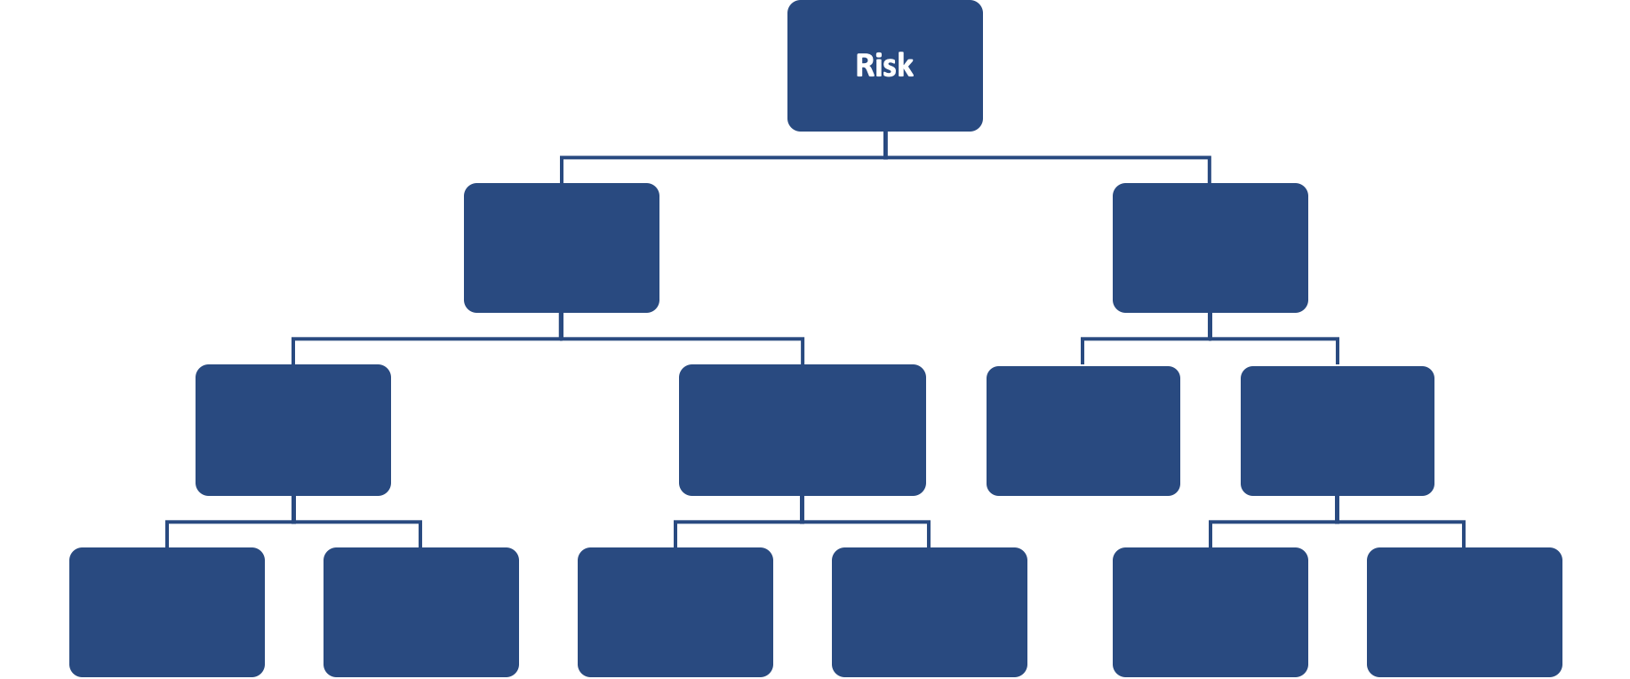
FAIR Open Course Module 6 – Presenting The Results Ver. 0.1 / Last Update: 14/09/2019

Slide 5
Presenting The Results
This module will cover some pointers on how to present the results.
These will mostly be some guidelines and are dependent on the objective of the risk analysis and who it is reported to.
Some risk analysis might be conducted for operational or tactical reasons, the results are not shared with higher management and the decisions can be made by middle management. For example it could be in situation like “Should we invest in security awareness training or subscribe to a new email security service?”

Slide 6
Presenting The Results
In other cases there might have been a bigger concern and the risk was decomposed with one part related to Cyber or operational risk for which FAIR was used. In this case the results are fed back to another team to complete the bigger picture. For example a company is planning to expand into the European market and as part of all the concerns they need to include risks related to GDPR.

Slide 7
Template
You can use a template to record and keep track of all the important points that were considered for the analysis or resulted from the analysis.
The template is a record of the data collected, assumptions etc. and for interest to the risk analysis team. It is not typically shared with others and referred to when there are questions.
The shared template is based on one shown by the FAIR Operational Risk Workgroup. Create whatever template works for you.

Slide 8
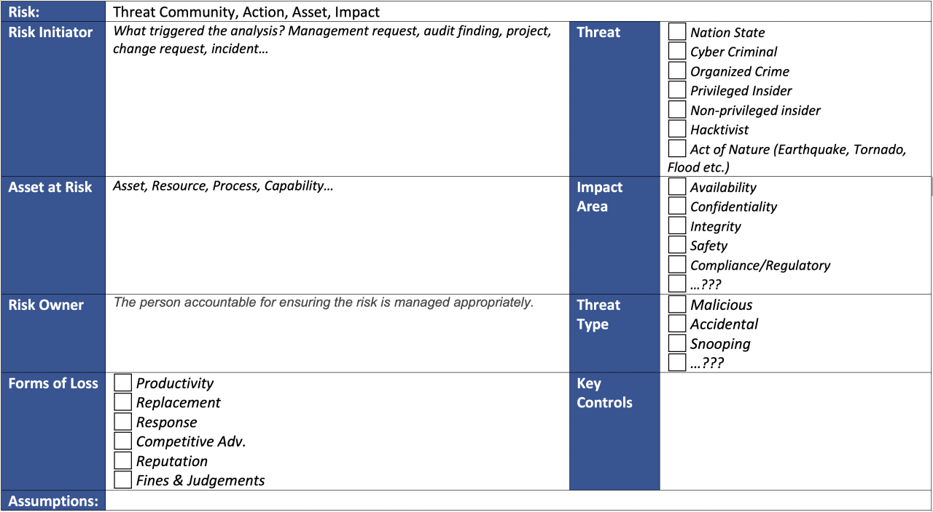

Slide 9
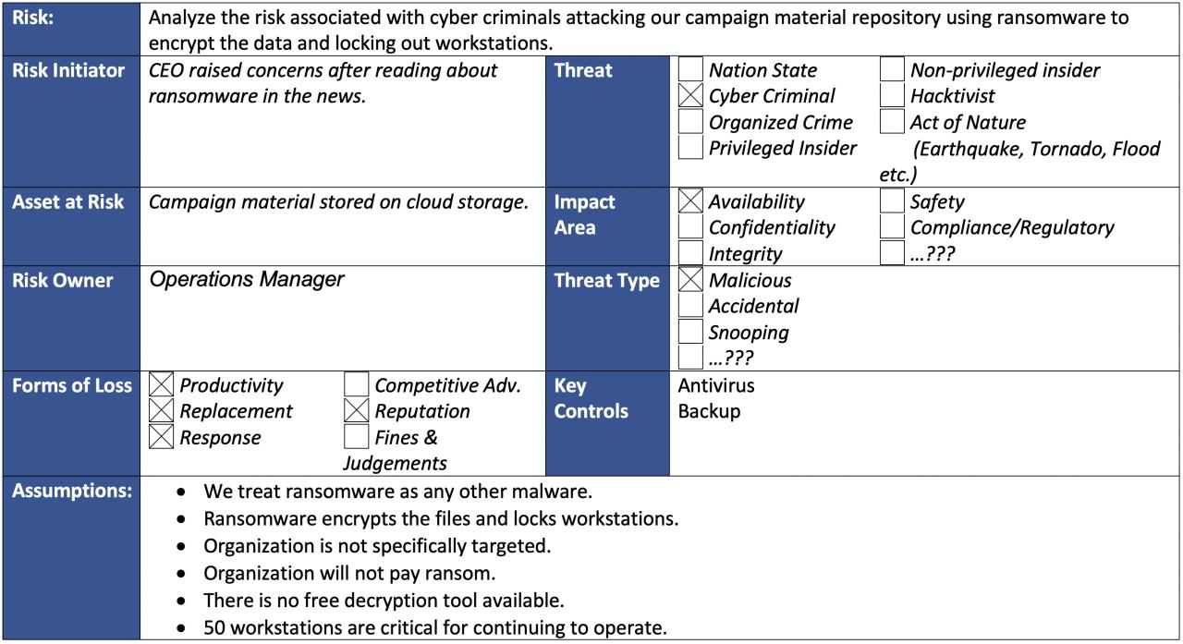

Slide 10
QA Check
Like in school one should do a quick quality assurance check to make sure the results make sense.
Basically look at the end results and see if they make sense.
A typical source of error is simply having plugged in wrong numbers into the tool for the simulation.
Simple Check:
Look at the min/ml/max annualized loss exposure results.
Look at the single event results.
Look at intermediate calculations. For example if you derived LEF, TEF or Vulnerability review if it makes sense (you can’t check that in FAIR U)

Slide 11
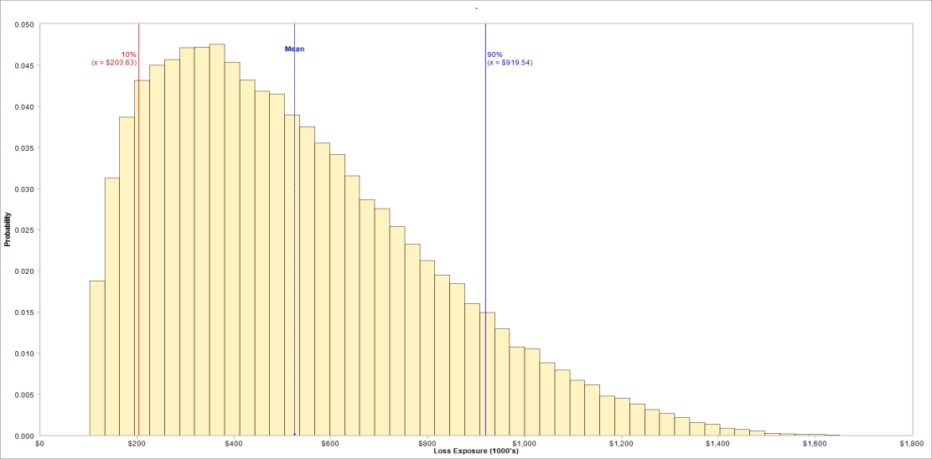
ALE Average (Mean) and Most Likely (Mode)
Most Likely
Most Likely (Mode): The bin in the histogram that is the highest.
This is where more scenarios occurred then in other bins.
Average (Mean): Is the sum of all loss exposures divided by number of scenarios.
Average can be misleading due to outliers (long tails).
If possible show the distribution. It tells a complete story that single numbers can’t.
Range between 10% and 90% percentile is the range that covered 80% of all loss exposures.
Usually interesting when there are long tails (outliers)
Average

Slide 12
Risk Qualifiers
FAIR lists two situations that require special attention on reporting if they occur; they might not be apparent from looking at the charts.
Fragile: TEF is high, LEF is low but there is only a single preventive control. This is like a single point of failure, no defense in depth and the situation is “fragile”.
Unstable: LEF is low just because TEF is low not that LEF is actually managed. This is an unstable condition because changes that result in TEF suddenly increasing will result in risk increasing. For example a privileged insider threat has a low TEF, but situation changes and the privileged insiders motivation and intentions change.

Slide 13
Presenting the Results
Use a PowerPoint presentation or a written report. Whatever works best for your organization.
It’s good to maintain a particular structure that works best for you.
Make sure you understand your audience.
What is their expectation?
What are they supposed to get out of your report?
How are you supporting them?
Make sure the audience has a general understanding of your risk analysis process.
Make sure assumptions made are clarified.
Presenter could be a risk analyst or even better the risk owner. Whatever works best for you.

Slide 14
Presentation Structure
Summary
Problem definition: Asset, Threat, Impact
Assumptions
In-scope / out of scope
People involved: SME’s, Asset owner…
The Model
Estimates
Provided by who
Rational, Limitations, Confidence
Conditions that could have improved estimates
Results
Summary: ALE Min , Most Likely , Average, Maximum
Details: Probability Distribution, Loss Exceedance Curve, Per Event Details
Mitigation Options
Appendices
Notes:
This is a proposed structure. Use whatever structure works for you.
For sake of consistency and to create a familiarity with the audience try as much as possible to stick to a template.
Avoid technical terms, but use and explain them if you have to. Don’t make assumptions that everyone knows what DDOS, Ransomware etc. means. Explain terms as they are relevant for your analysis in a simple language (without sounding condescending!)

